Slide 1
Smart Parking for Smart Cities
Creating a resilient parking way!

Slide 2




Team Members
Shalini S
Front-End Developer
.
Srinidhi R
Presentor
.
Vijayvenkatajalapathi G
Leader, Front-End Developer
.
Suganth M
Back-End Developer
.
Team Mentor : Ms. Renugadevi G Industrial Mentor : Theophila
Team White!

Slide 3
Problem Statement - Smart Parking for Smart Cities
Major Issues in Urban Parking includes,
Shortage of parking space
Traffic congestion due to visitors in search for a parking place.
Unorganized Parking and Unregulated Tariffs

Slide 4
Abstract of our Proposed Solution
Our Smart Parking System is based on Image processing (OpenCV) to detect and manage the availability of parking spaces.
Our Approach provides a platform to rent street-side park area, thereby increasing the parking space.
An user friendly app that can be used to search nearby parking spots, can book priorly and pay online through wallet, thus removing traffic congestion.
Also, Added Navigation feature for the newbies.

Slide 5
Technology Stack
React Native - Frontend
Python, OpenCV, Google Maps API
IOT Devices – Camera etc.
PHP - Backend
MySQL - Database

Slide 6
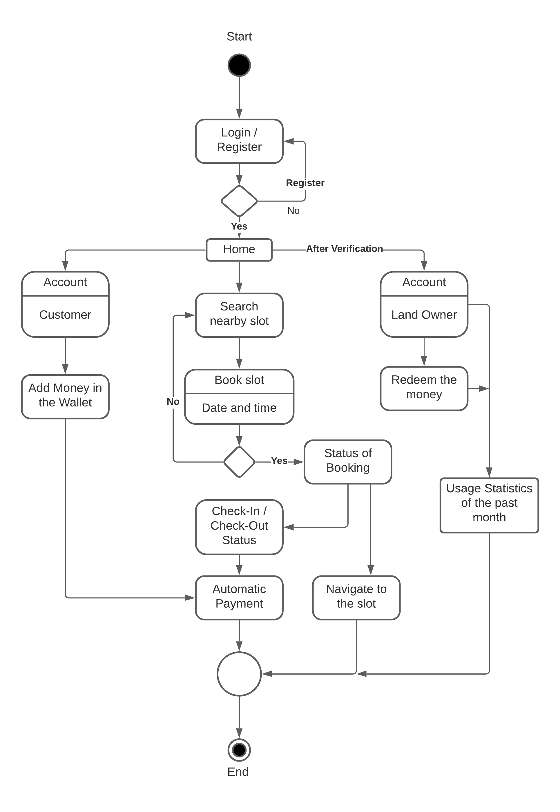
UML Diagram

Slide 7
Our Future Enhancements
Slot suggestions based on User reviews and ratings
Scaling up the parking options
Enabling Long-term parking options in Rented Area
Reminders of previously parked slot

Slide 8
Demo

